Slide 1
Huff Research Group Kendra Andersen
Presentation 2/16/18

Slide 2
Project Description
Navigation in Radio Frequency Landscapes using Autonomous Vehicles and Multiple Antenna Systems
Collect data on signal strength of various antenna systems using autonomous rovers.
Develop algorithm to plan a route for the rover which maximizes received signal strength (RSS).
Develop control strategy to examine signal strength at various frequencies for a GPS location and determine the best antenna configuration to maximize RSS.

Slide 3
Status
Last Week:
Coming up:
Got data from Sarah & started testing it.
Implemented algorithm for determining the best path to maximize power from specified transmitters or to maximize SNRs.
Determined plotting strategy for the data when it’s using GPS coordinates.
Get GPS coordinates on data.
Additional data from Sarah at other frequencies & antenna configurations.
Given choice of path and antenna configuration, select the optimum setup.
Given choice of path, antenna configuration, and directionality, select optimum setup.

Slide 4
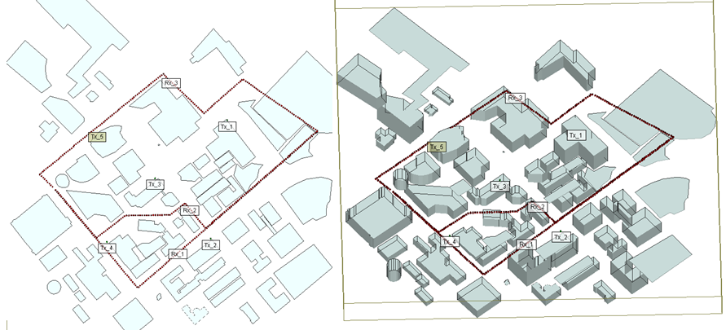
TAMU Engineering Quad with Three Paths

Slide 5
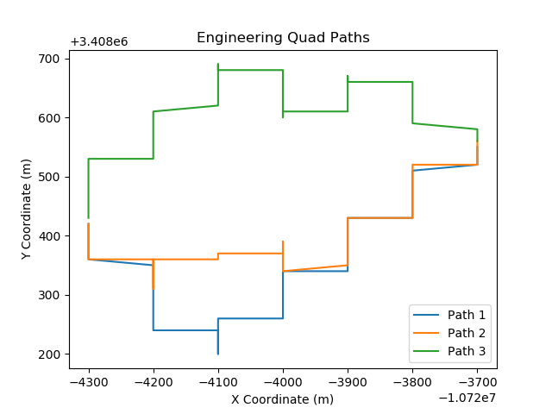
Coordinate Rounding Issue
The image should look like the previous slide.

Slide 6
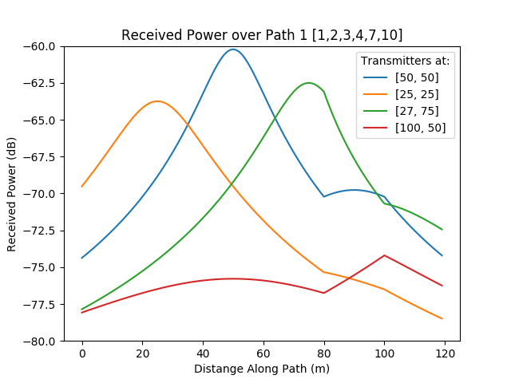
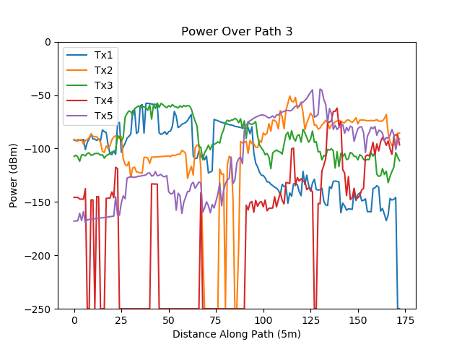
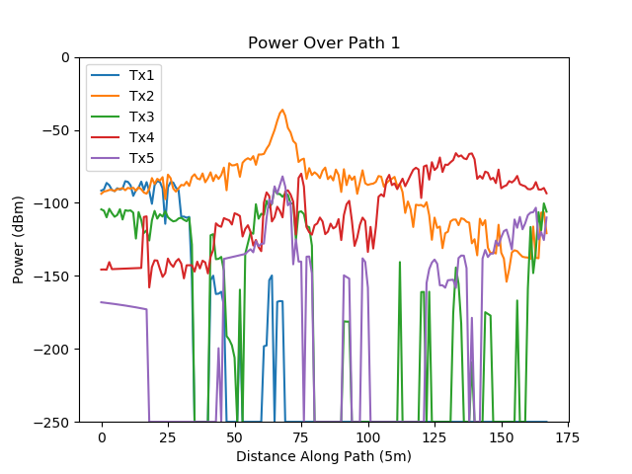
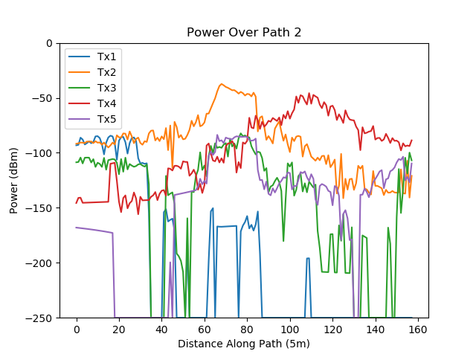
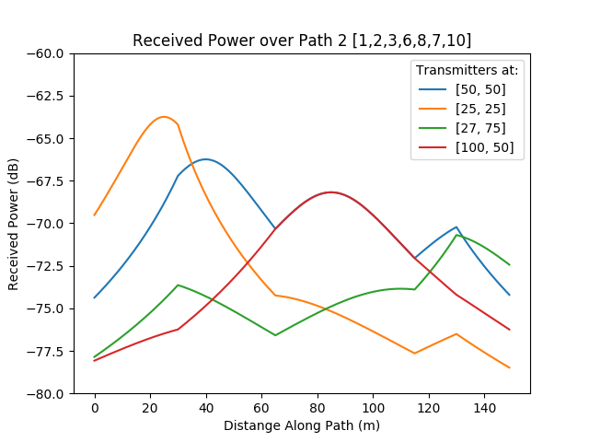
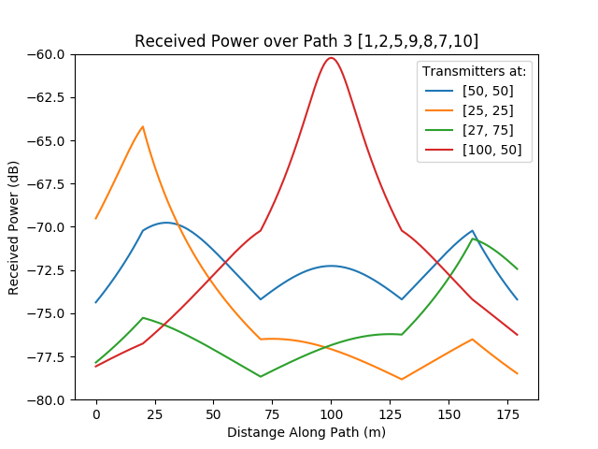
TAMU Engineering Quad with Three Paths
These plots show data for a Horn Antenna at 900 MHz.

Slide 7
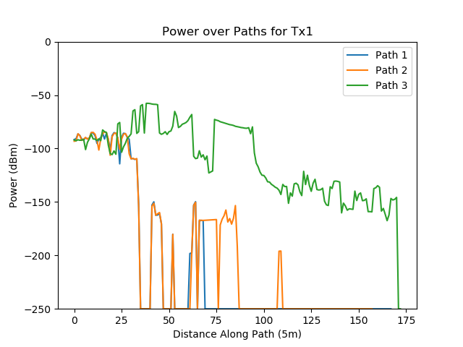
Findings/Progress
Sample Output:
Path 3 maximizes power from Tx1

Slide 8
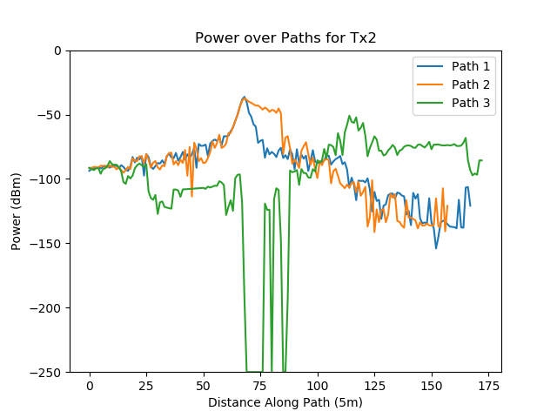
Findings/Progress
Sample Output:
Path 2 maximizes power from Tx2

Slide 9
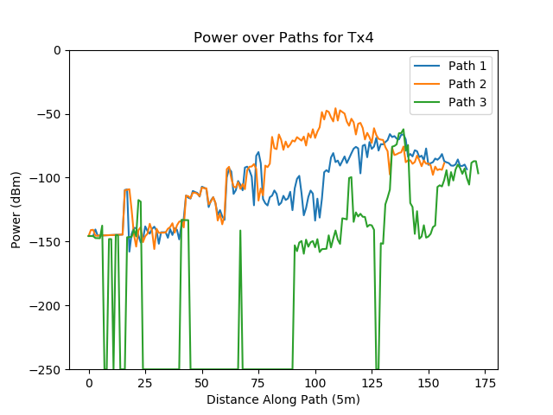
Findings/Progress
Sample Output:
Path 2 maximizes power from Tx4

Slide 10
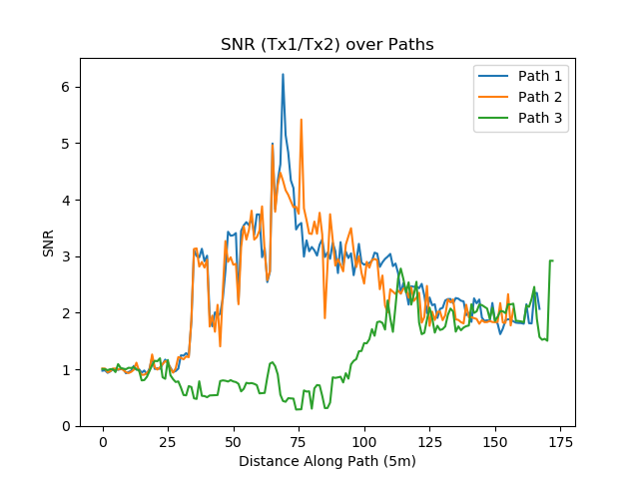
Findings/Progress
Sample Output:
Path 1 maximizes SNR of Tx1/Tx2

